Slide 1
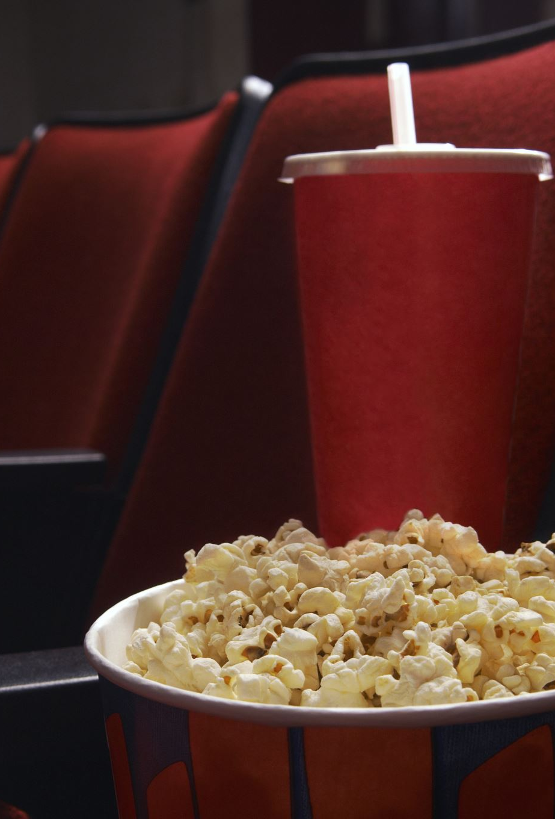
Theater Ticket Management System
Group 13:
Hanpeng Yang
Het Ashwinbhai Patel
Mihir Sanjay Rahate
Omkar Nitin Vaity
Sneha Alluri

Slide 2
Overview
Manager
Managing movies and associated actors, genres
Managing studios and associated seats
Managing movie schedules and tickets
Managing special events
Checking out statistics
Clerk
Checking out information about movies, studios, schedules
Selling and refunding tickets
Online Customer
Checking out information about movies, studios, schedules
Buying tickets online
Leaving comments about movies they’ve watched
Leaving feedbacks about the facility

Slide 3
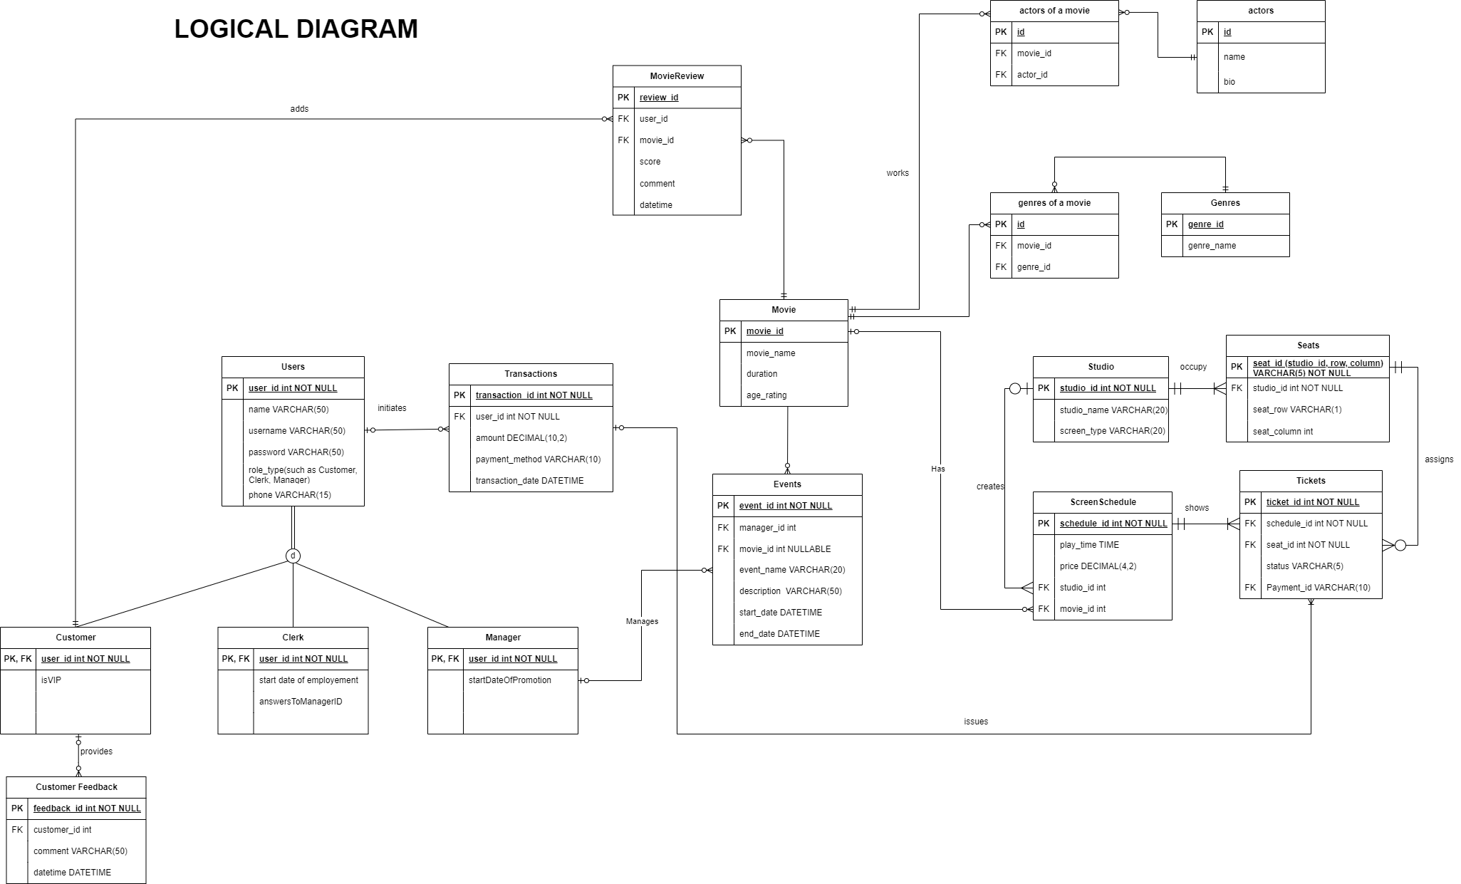
ERD

Slide 4
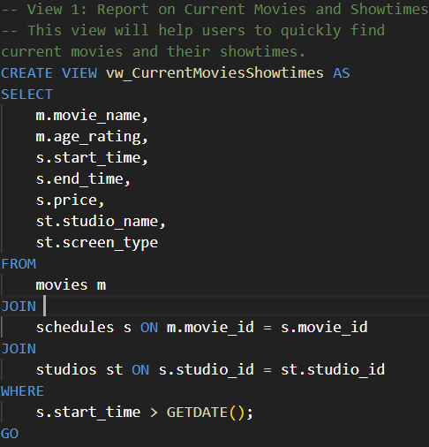
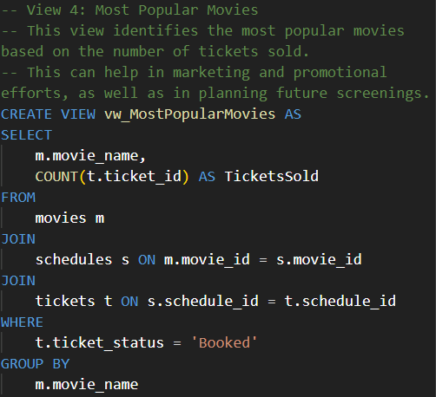
Views

Slide 5
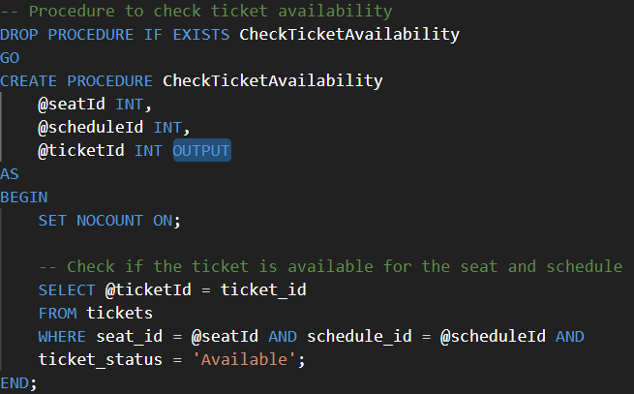
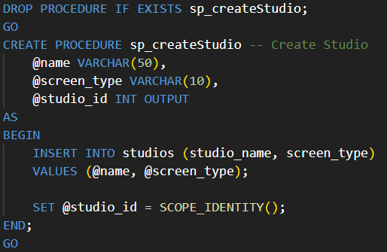
Procedures

Slide 6
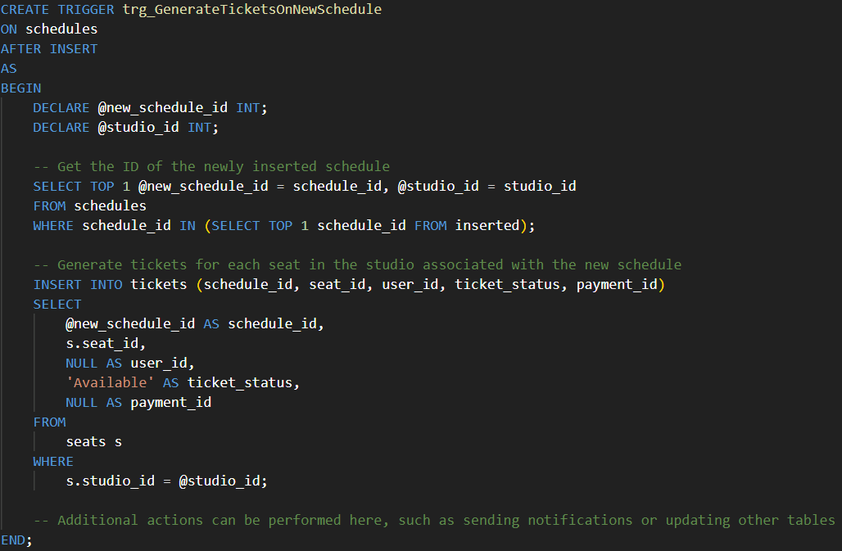
Triggers

Slide 7
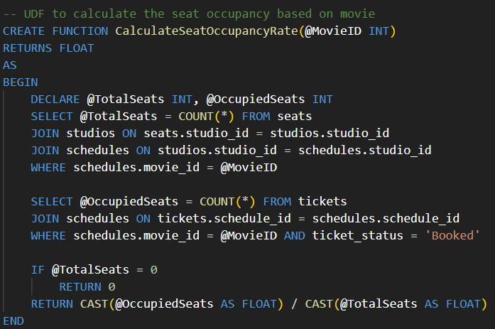
Functions

Slide 8
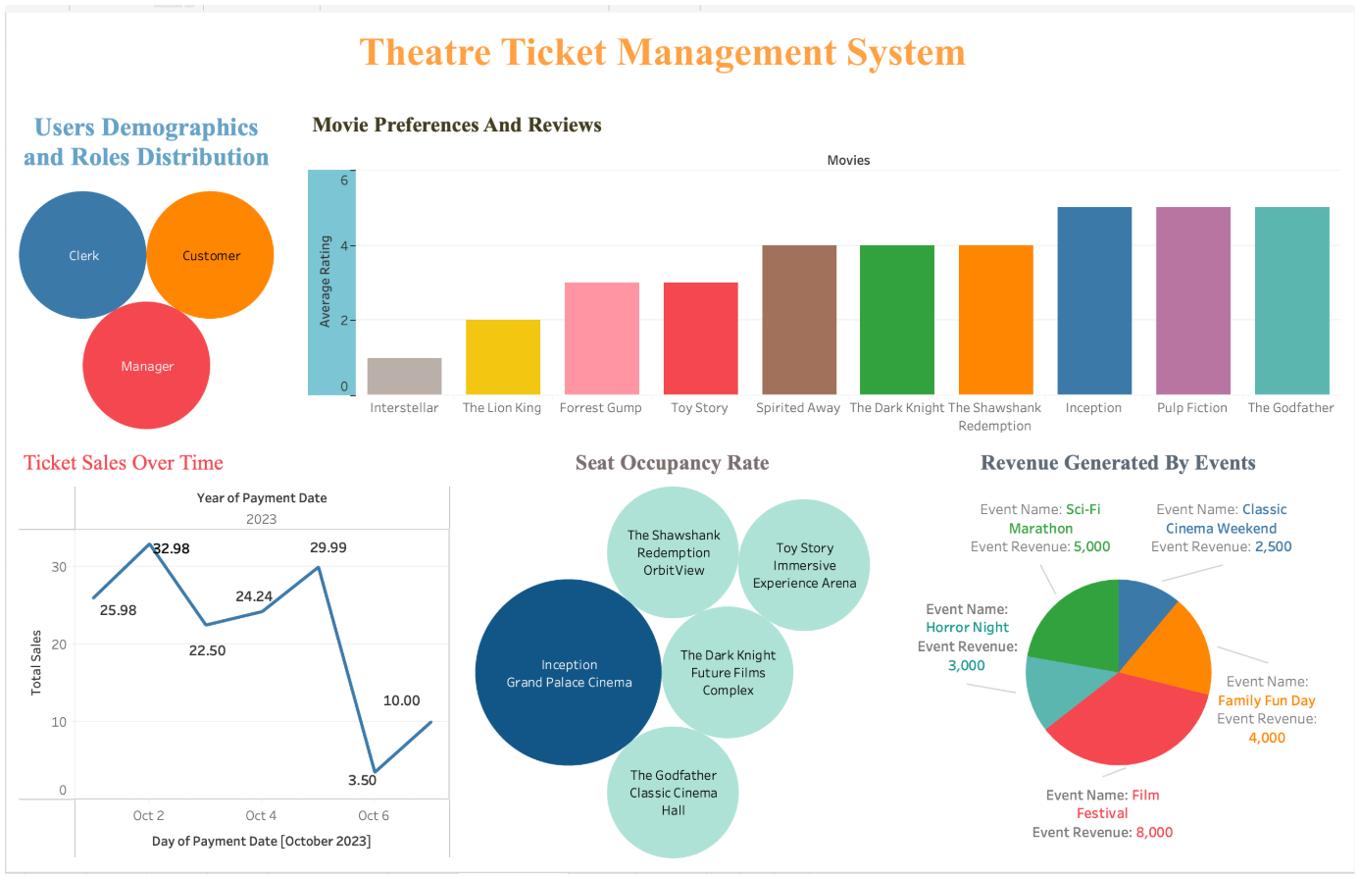
Visualization

